Slide 1
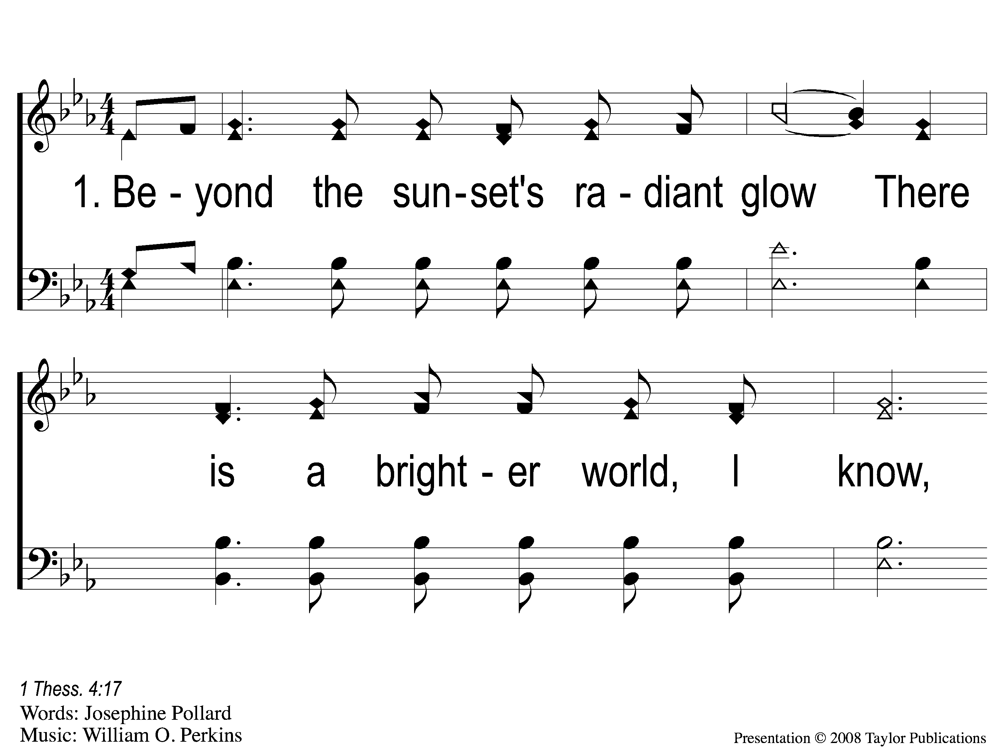
1-1 Beyond the Sunset
Beyond the Sunset
44

Slide 2
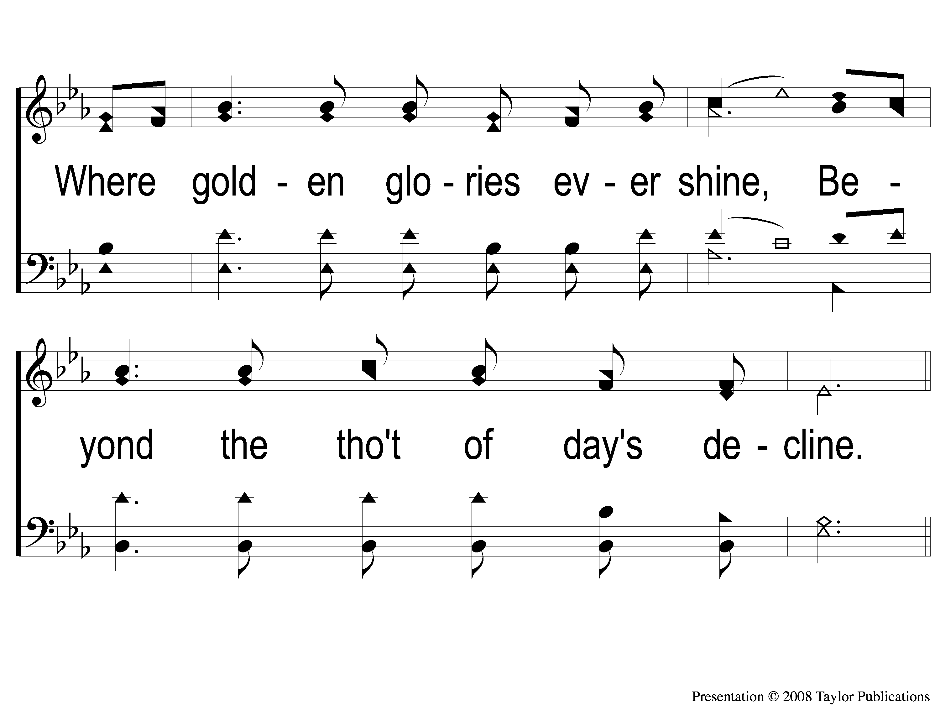
1-2 Beyond the Sunset
Beyond the Sunset
44

Slide 3
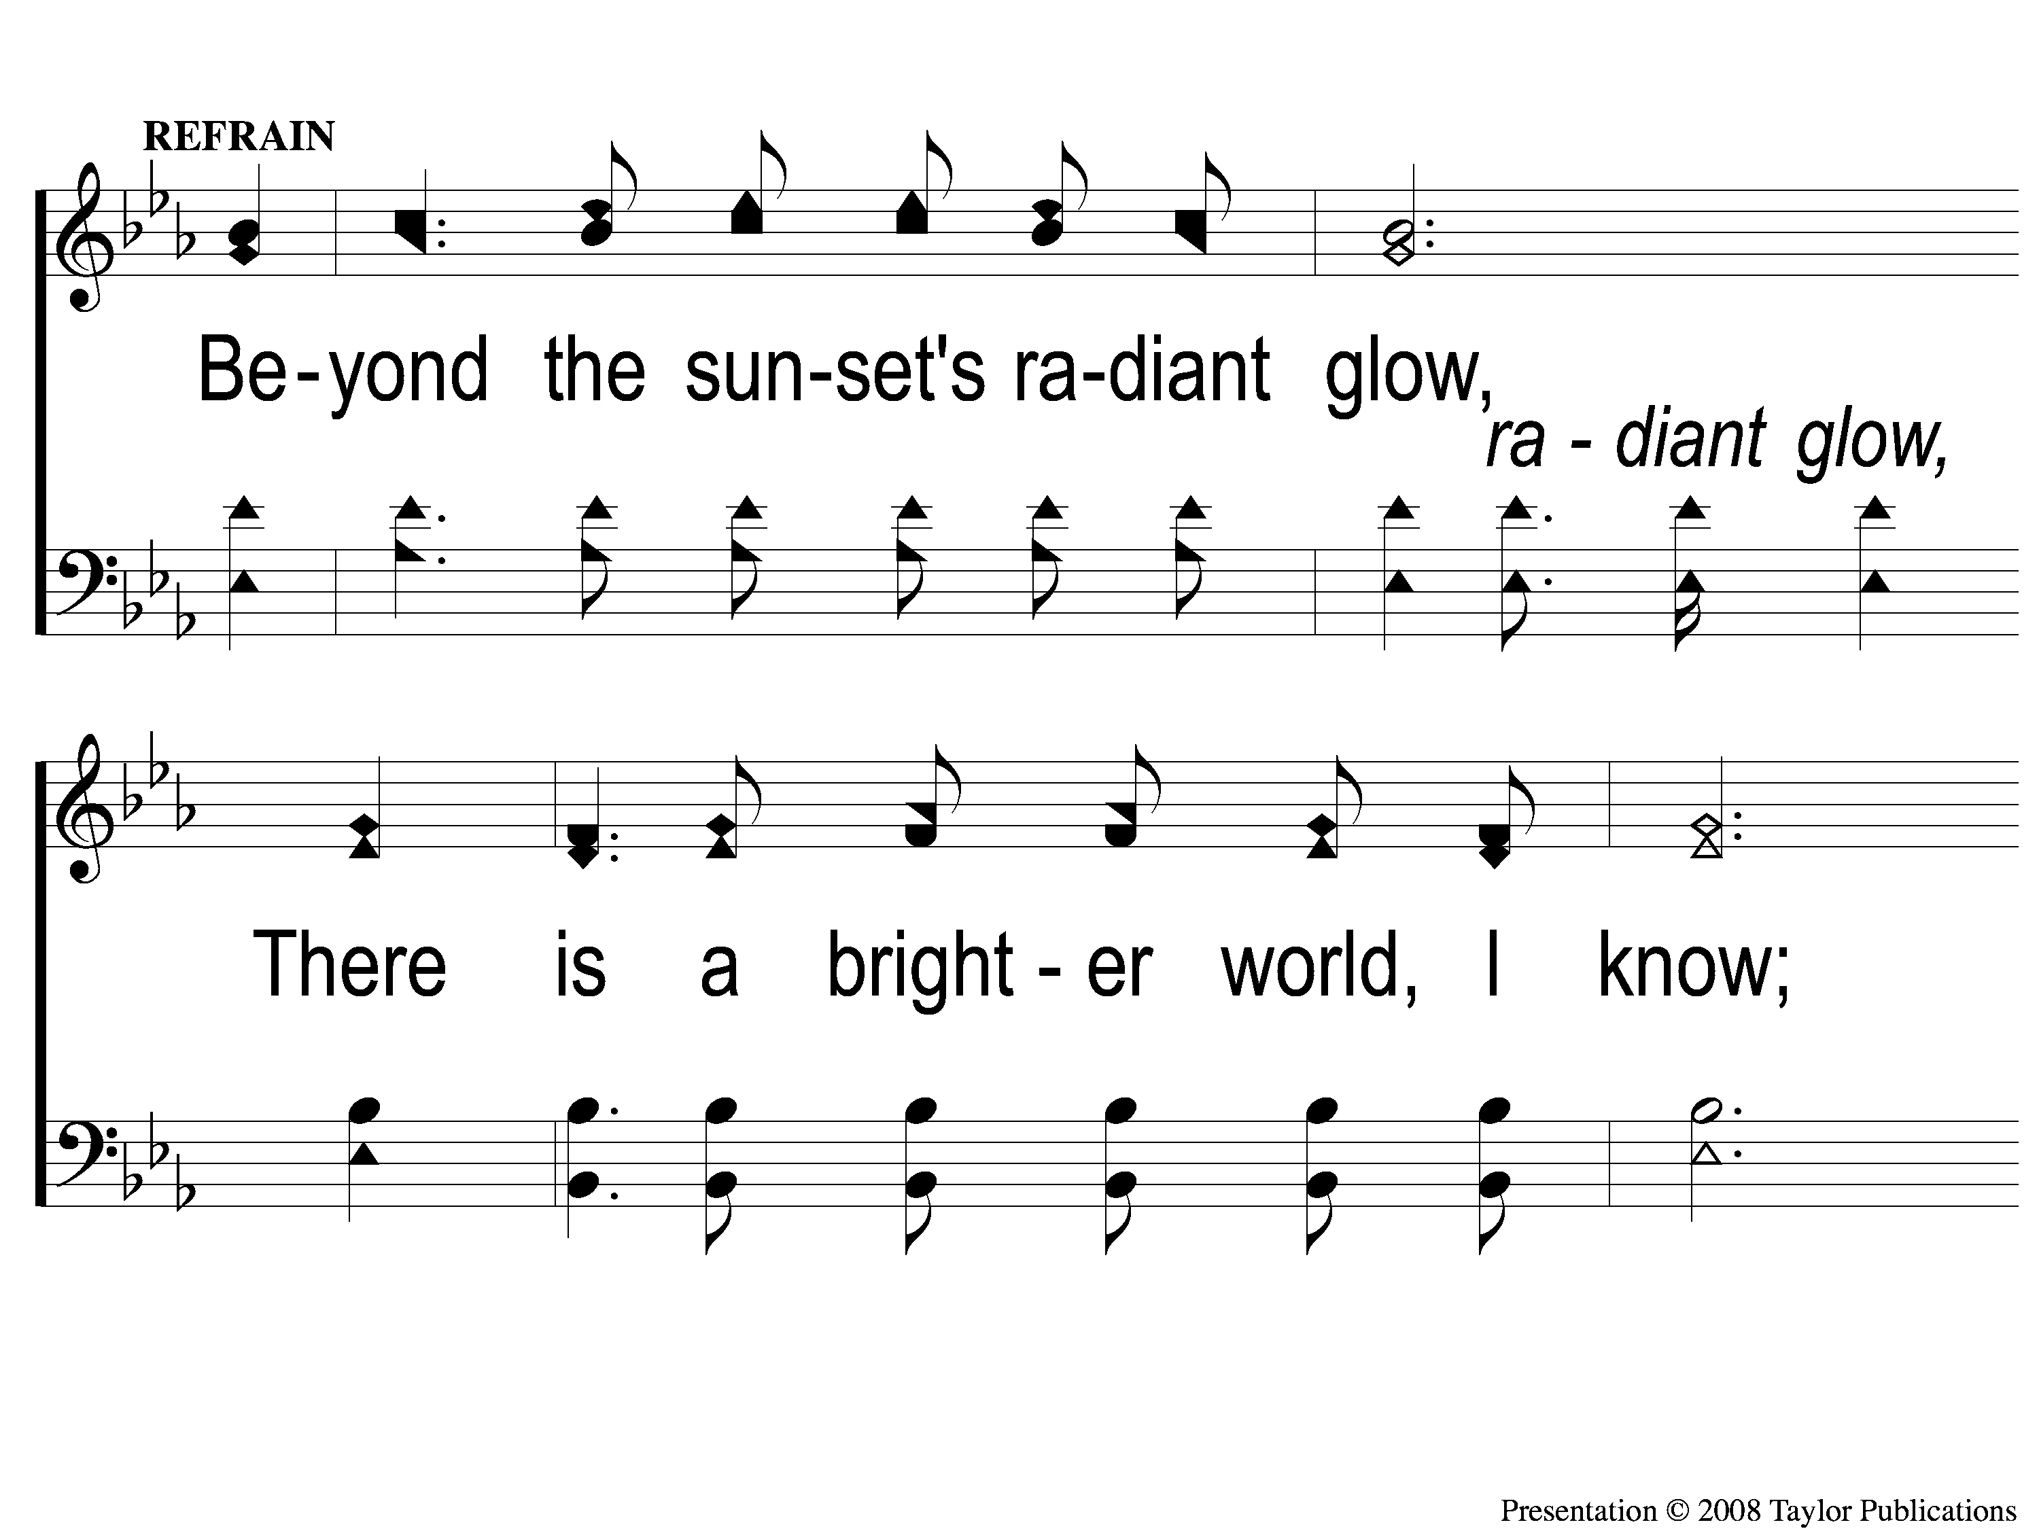
C-1 Beyond the Sunset
Beyond the Sunset
44

Slide 4
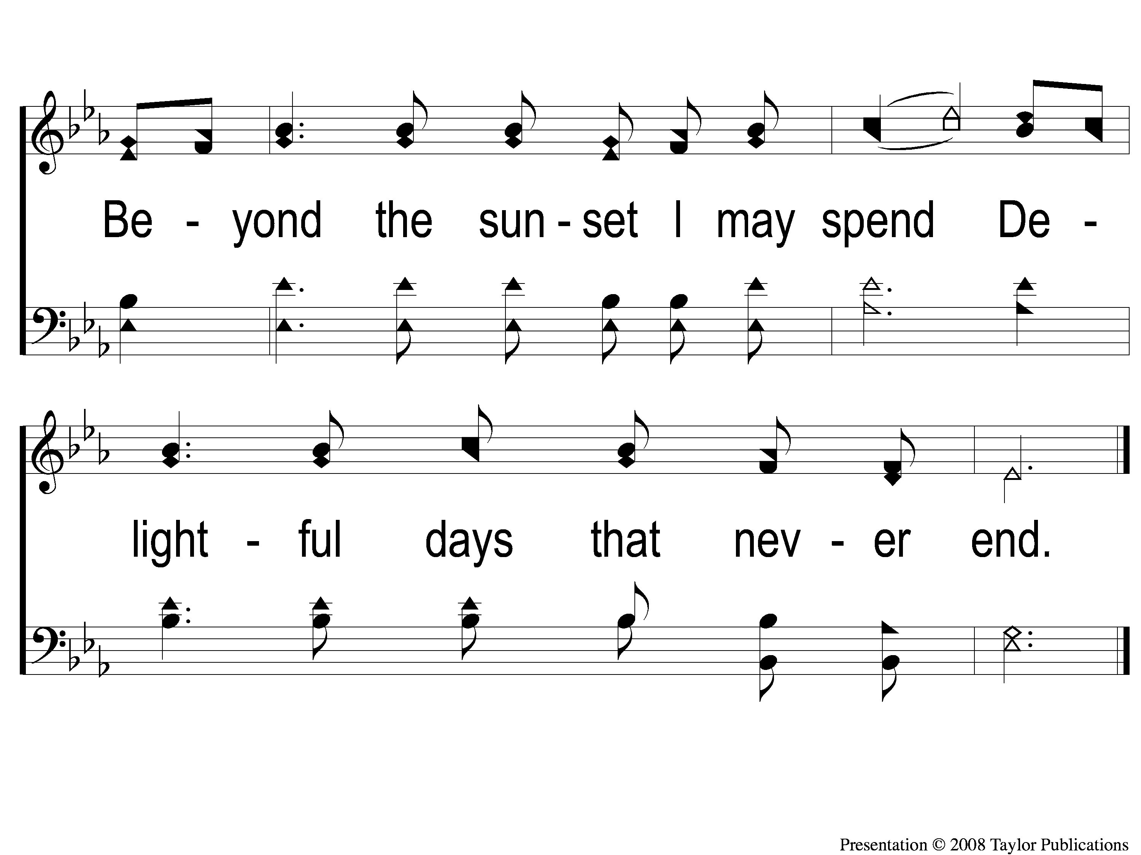
C-2 Beyond the Sunset
Beyond the Sunset
44

Slide 5
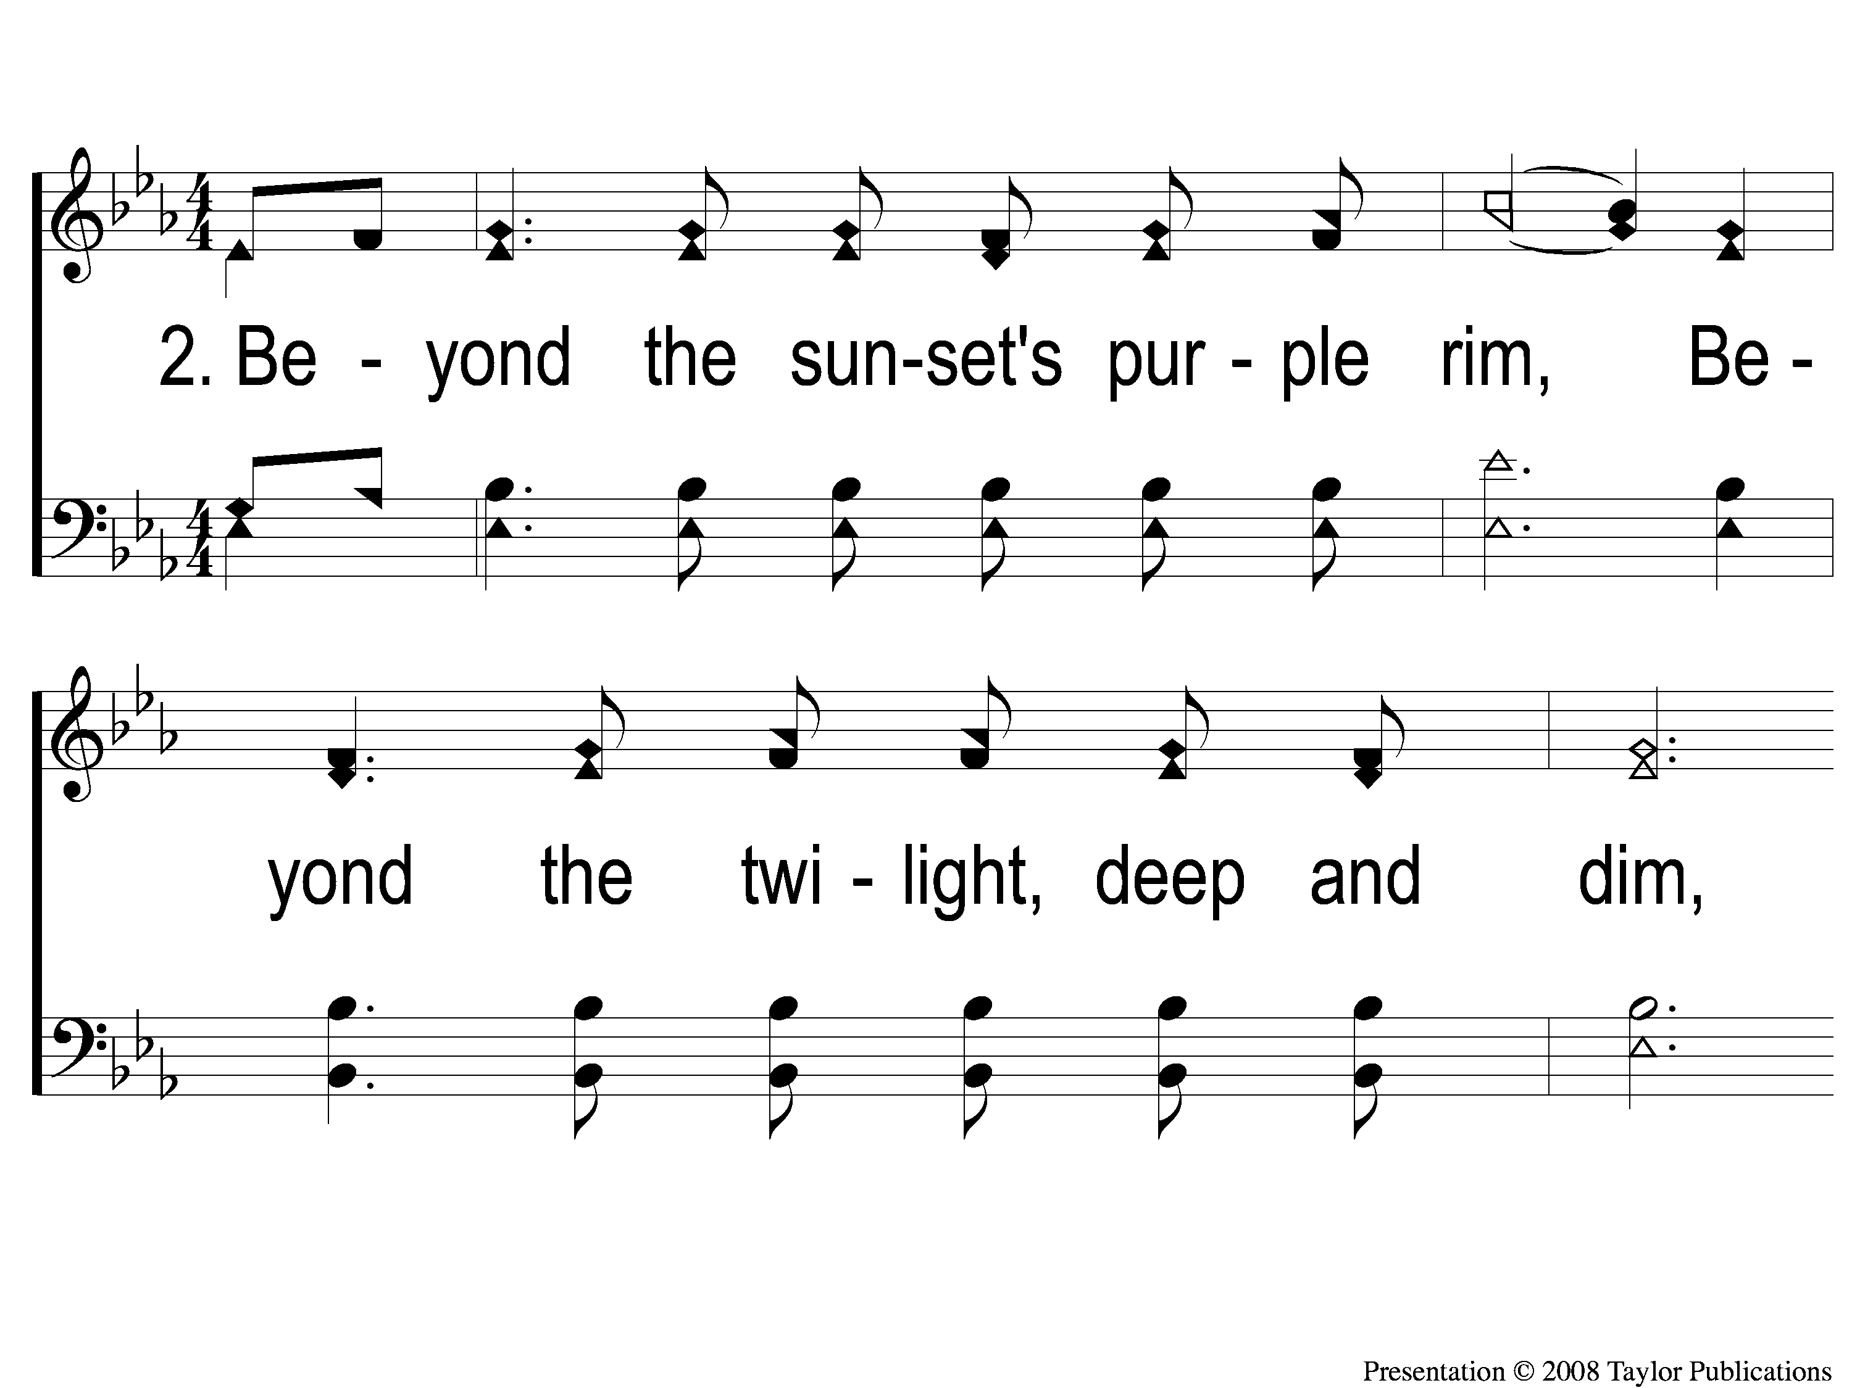
2-1 Beyond the Sunset
Beyond the Sunset
44

Slide 6
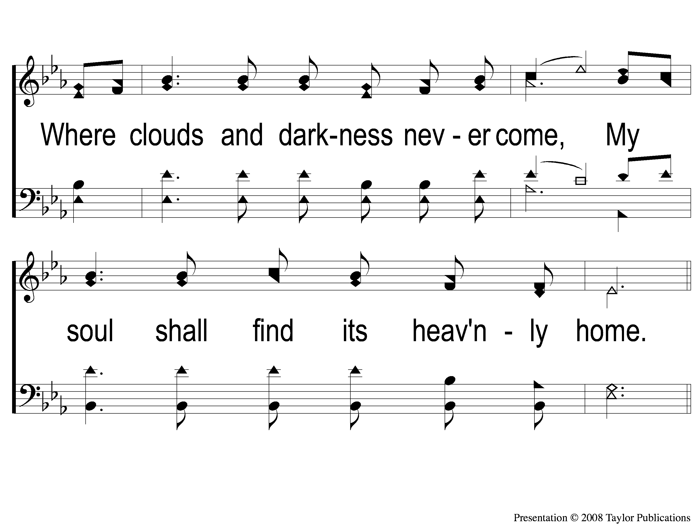
2-2 Beyond the Sunset
Beyond the Sunset
44

Slide 7
C-1 Beyond the Sunset
Beyond the Sunset
44

Slide 8
C-2 Beyond the Sunset
Beyond the Sunset
44

Slide 9
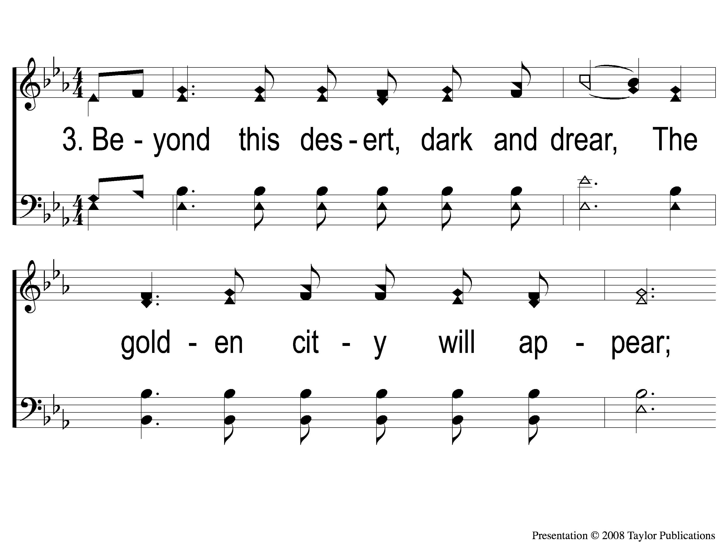
3-1 Beyond the Sunset
Beyond the Sunset
44

Slide 10
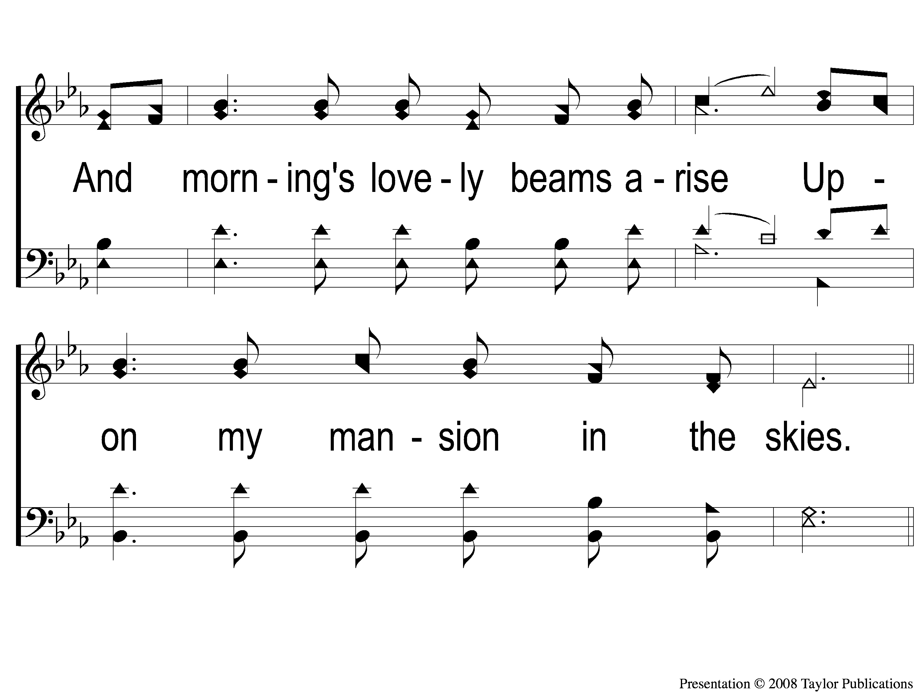
3-2 Beyond the Sunset
Beyond the Sunset
44

Slide 11
C-1 Beyond the Sunset
Beyond the Sunset
44

Slide 12
C-2 Beyond the Sunset
Beyond the Sunset
44

